Slide 1
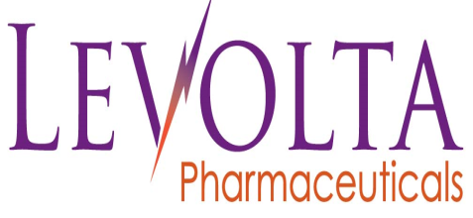
VOLT03
Reformulated Curcumin
Pharma-grade with an enhanced therapeutic index

Slide 2
Levolta reformulates approved products to enhance their customer value, such as efficacy, safety and convenience.
VOLT03, a reformulated curcumin complex, improves the solubility of the compound and may be used for a diverse array of indications.
VOLT03, has demonstrated superior efficacy to curcumin and indomethacin in animal studies.
VOLT03 will be commercialized in 2016 as a nutraceutical, sold on the Over-The-Counter (OTC) market.
Executive Summary

Slide 3
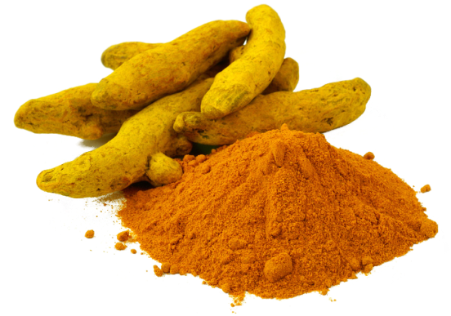
Levolta is currently focused on the commercialization of its complexed curcumin, VOLT03, which will be the only pharmaceutical-grade curcumin with an enhanced therapeutic index
Current Focus

Slide 4
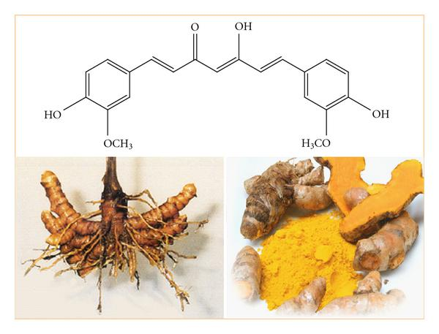
Introduction
Curcumin (diferuloylmethane) is a yellow pigment present in the spice turmeric (Curcuma longa) that has been associated with antioxidant, anti-inflammatory, anticancer, antiviral, and antibacterial activities as indicated by over 6,000 citations.
In addition, over one hundred clinical studies have been carried out with curcumin and another 100+ currently ongoing per clinicaltrials.gov

Slide 5
10 Proven Health Benefits of Curcumin
Contains Bioactive Compounds with Powerful Medicinal Properties
Natural Anti-Inflammatory Compound
Natural anti-oxidant
Boosts Brain-Derived Neurotrophic Factor, Linked to Improved Brain Function
Lowers Risk of Heart Disease
Can Help Prevent (And Perhaps Even Treat) Cancer
May be Useful in Preventing & Treating Alzheimer’s Disease
Arthritis Patients Respond Very Well to Curcumin
Studies Show Incredible Benefits Against Depression
May Help Delay Aging and Fight Age-Related Chronic Diseases
Opportunity

Slide 6
VOLT03 in Paw Edema model
The efficacy of VOLT03 was compared to native curcumin, indomethacin and placebo in a carrageenan mouse paw edema model.
Group No. | No. of Animals | Test Article | Dose Route | Dose Level (mg/kg) | Dose Volume (mL/kg) | Dose Conc. (mg/mL)
1 | 8 | Vehicle | p.o. | N/A | 10 | N/A
2 | 8 | Curcumin | p.o. | 30 | 10 | 3
3 | 8 | VOLT03 | p.o. | 30 | 10 | 3
4 | 8 | Indomethacin | p.o. | 5 | 10 | 0.5
Superior Preclinical data
Methods: The paw was measured at 3 hours after oral gavage of curcumin (30 mg/kg), Indomethacin (5 mg/kg), and VOLT03 (30 mg/kg) to mice.

Slide 7
VOLT03 in Paw Edema model
Swelling (mm)
Superior Preclinical data
Results: After 3 hours, the swelling was 0.59 mm for VOLT03, 0.66 mm for curcumin, 0.73 mm for indomethacin, and 0.78 mm for vehicle control. The difference between VOLT03 and curcumin/indomethacin was statistically significant, with p<0.05.

Slide 8
$MM
Total Addressable U.S. Market
Recent data from the Nutrition Business Journal puts turmeric in the top 10 best-selling supplements in the U.S.
The total U.S. dietary supplement market of curcumin is estimated at several hundred tons.**
**www.nutraingredients-usa.com/Suppliers2/Any-moment-now-Is-curcumin-momentum-building-towards-a-tipping-point
* Nutrition Business Journal estimated sales of curcumin and turmeric-based supplements

Slide 9
"Curcumin is the most widely-studied plant-derived medicinal chemical in modern science. Based on a statistical analysis of over three million published scientific studies, Curcumin is the most frequently mentioned phytonutrient.“
- *NaturalNews.com, July 2013
There are 50+ manufacturers selling standard curcumin but most have very poor solubility and corresponding poor Pk.
Competition
Main Enhanced Curcumin competitors:
1. Wacker Chemie - CAVAMAX® W8 Curcumin Complex (+ cyclodextrin)
2. OmniActive - CircuWin™ (utilizes UltraSOL™ technology)
3. Indena - Meriva® (curcumin-phosphatidylcholine phytosome complex)
4. Arjuna – BCM-95® (pure tumeric extract + essential oils)
5. Sabinsa - Curcumin C³ Complex® (curcumin + BioPerine)
*http://www.naturalnews.com/041329_curcumin_anti-cancer_scientific_literature.html

Slide 10

Highly purified pharmaceutical-grade active ingredients.
Manufactured under GMP in FDA-approved site.
Only curcumin product to demonstrate statistically significant anti-inflammatory properties vs standard curcumin and an NSAID (indomethacin).
Enhanced bioavailability allows for less frequent dosing.
Highly soluble thus final dosage form will be in a small vegetable capsule.
Advantages of VOLT03

Slide 11
Levolta is seeking a sales and / or distribution partner.
Levolta is interested in global, regional and local partnering opportunities.
VOLT03 is projected to be commercialized in 1H 2016.
Partnering Opportunity

Slide 12
After reviewing this Presentation Deck please feel free to contact Mr. Richard Becker with any questions you may have.
Contact Information
Richard Becker, CEO
Levolta Pharmaceuticals
Rbecker@levoltapharma.com
848.702.0682

